Slide 1
…

Slide 2

Auditorium
The Growth and Development of the New Testament Church
Eastside Curriculum – Qtr 14 (Nov. 2025 – Jan. 2026)

Slide 3
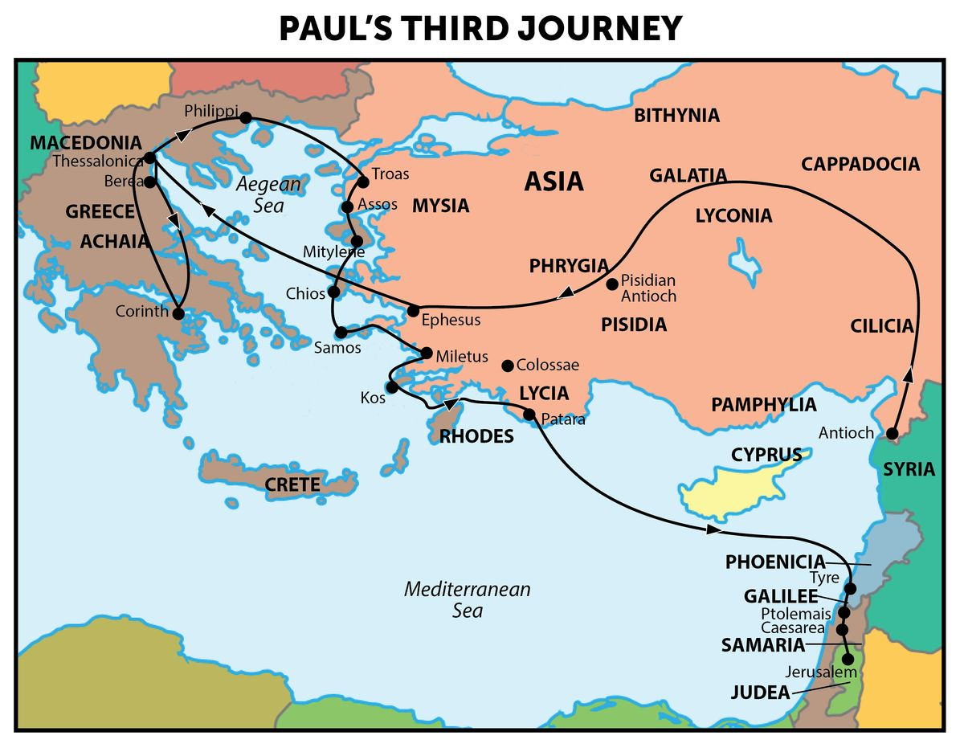
REVIEW
Letters Paul wrote on this journey
Galatians
1 & 2 Corinthians
Romans

Slide 4
Review
Paul’s resolve and commitment Acts 20:22-24 and Acts 21:11-14
Jews from Asia stir up the crowd and laid hands on Paul 21:27
False Accusations 21:28-29
The Romans step in 21:31-32
Asks to speak to the crowd 21:39
Gives an account of his conversion/Teach the Gentiles 22:1-24
  They listened to him until this word
Commander ordered him to be brought to the barracks v 24

Slide 5
Paul tells them that he is a Roman 22:25-29
“Is it lawful to scourge a man who is a Roman and uncondemned?”
  The centurion told the commander that Paul was a Roman
  Paul tells the commander that he was born a citizen
  Romans were now afraid and withdrew from him

Slide 6
Appears before the Sanhedrin 22:30 – 23:10
Commander wanted to know why he was accused by the Jews 22:30
  Released him from his bonds
  Commanded the chief priests and the council to appear
  Set Paul before them

Slide 7
Appears before the Sanhedrin 22:30 – 23:10
He begins to speak to them 23:1
Paul is reprimanded for being disrespectful 23:4-5 Ex 22:28
  He admits he wouldn’t have had he known
He recognizes the opportunity to exploit their differences 23:6
  Some were Sadducees and some were Pharisees
    They did not agree on the resurrection*
Dissention arose and the assembly was divided 23:7-8

Slide 8
Paul Appears before the Sanhedrin 22:30 – 23:10
Scribes who were of the Pharisees protested 23:9
  We find no evil in this man …. Let us not fight against God
Commander feared for Paul’s life 23:10
  Soldiers took him by force and took him to the barracks

Slide 9
The Lord Comforts Paul 23:11
But the following night the Lord stood by him and said, “Be of good cheer, Paul; for as you have testified for Me in Jerusalem, so you must also bear witness at Rome.”
Wednesday - Acts 23:11-35

Slide 11
1)
2)
3)
4)
5)
6)
7)
8)
9)
10)
11)
12)
13)
14)
15)
Ascension & Appointment
Philippian Prison
16)
17)
18)
19)
20)
21)
22)
23)
24)
25)
26)
27)
28)
Pentecost & Peter’s Preaching
Addressing Athens
Lame Man & Lesson
Achaia, Antioch, & Apollos
Restrained, Released, & Request
Re-baptism, Repentance, & Riot
Deception & Detention
Macedonia & Miletus
Seven Selected
Jerusalem & Jewish Mob
Stephen Stoned
Review & Rejection
Samaria & Salvation
Council & Conspiracy
Saul Saved & Dorcas Delivered
Caesarean Confinement
Cornelius Converted
Appeal & Agrippa
Report & Relief
A
Review & Ridicule
Persecution, Peter, & Pride
Marooned On Malta
CTS
Antioch to Iconium
F
Rescued To Rome
Iconium to Antioch
ACTS
Disagreement & Decision
Alliteration Memory Statements To Help Recall Chapter Content
Notes:
Reference the Alliteration memory statements available for individual study of Acts and a means of helping each of us better study the book of Acts

Slide 12
Resolve/Commitment
Desire to share the gospel

